Slide 1
ROB TAYLOR - DIRECTOR OF BUSINESS DEVELOPMENT &
GOVERNMENT AFFAIRS PITTSYLVANIA COUNTY FTTH UPDATE AUGUST 20, 2024

Slide 2
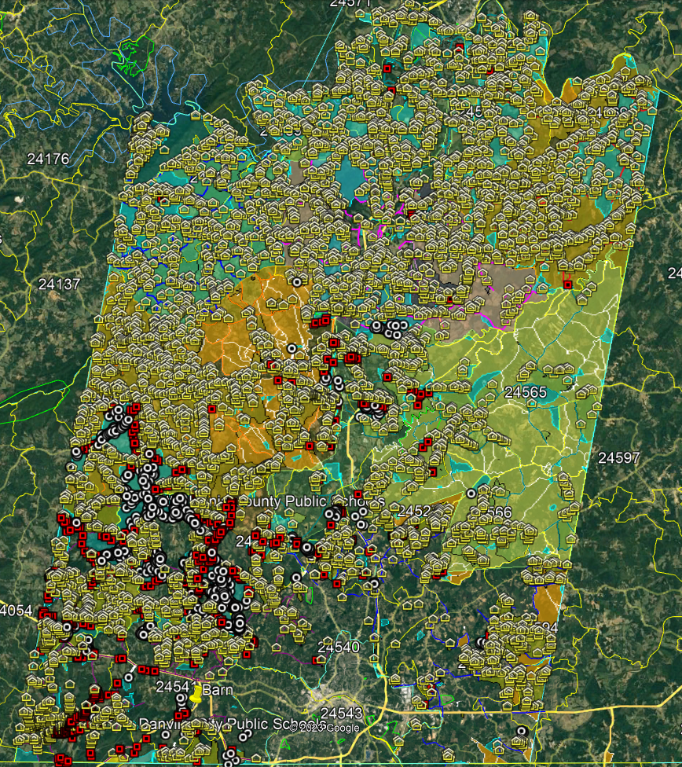
PITTSYLVANIA COUNTY – CAF II & VATI APPLICATION LOCATIONS
CAF II & VATI APPLICATION LOCATIONS PASSED BY RSN FTTH PLAN
RSN RDOF – 8,369
UNFUNDED – 3,616
VATI 2022 TOTAL - 11,985
VATI 2023 TOTAL - 2,102
CAF II - 2,412
GRAND TOTAL - 16,499
CAF AWARD PROJECT AREA
RDOF & VATI 22 LOCATIONS
VATI 23 LOCATIONS NEW FIBER
VATI 23 LOCATIONS EXISTING FIBER

Slide 3
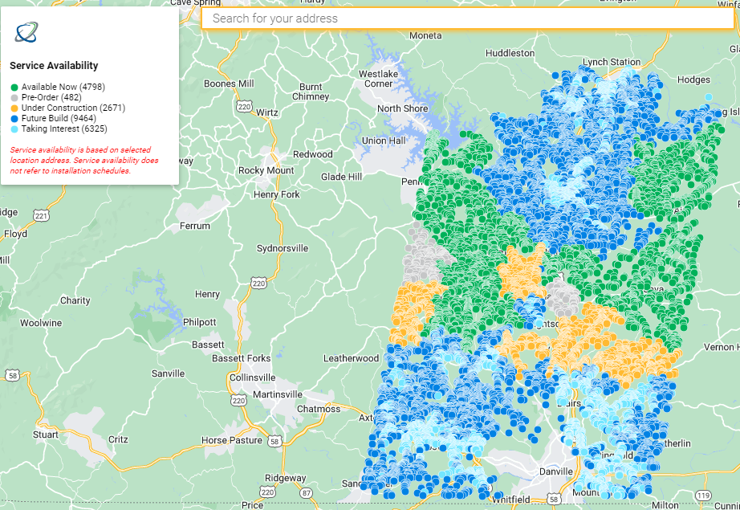
CURRENT SERVICE MAP

Slide 4
PITTSYLVANIA GENERAL INFORMATION
As of Wednesday, 08/14/2024 we had 760 customers installed which is an increase of 148 locations since our last reporting in June 2024
Currently have 309 orders in process
Since our last report the number of locations passed has increased from 3,790 locations to 4,798 or 1,008
With 1,069 locations installed or in process, the current take rate is 22% which is 50% higher than the June reporting of 14%
Strawberry cabinets 7, 8, and 10 through 13 are currently under construction
Chestnut CO and cabinets 1 through 4 are currently under construction
453 locations are currently in Pre-Order Status
Since the last reporting, RSN Marketing team has had sign up events in Downtown Chatham, Java Fire Dept.(this was a Saturday event that was extremely well attended), County Community Center, Union Hall Elem School - Open House.

Slide 5
Pittsylvania County – Current Project Timeline
July Tasks Underway or Completed
Complete Construction - Strawberry Cabinets 7&9
Begin Splicing and Testing - Strawberry Cabinets 4&5
Begin Staking - Brightsville CO and Cabinet 3
Begin Construction - Chestnut CO and Cabinets 1-4
Tasks Up Next: August
Begin Construction in Strawberry Cabinet 8
Complete Splicing and Testing - Strawberry Cabinets 4&5
Complete Construction - Strawberry Cabinet 9
Begin Splicing - Strawberry Cabinet 9
Complete Brosville Staking - Construction to Begin Next Quarter

Slide 6
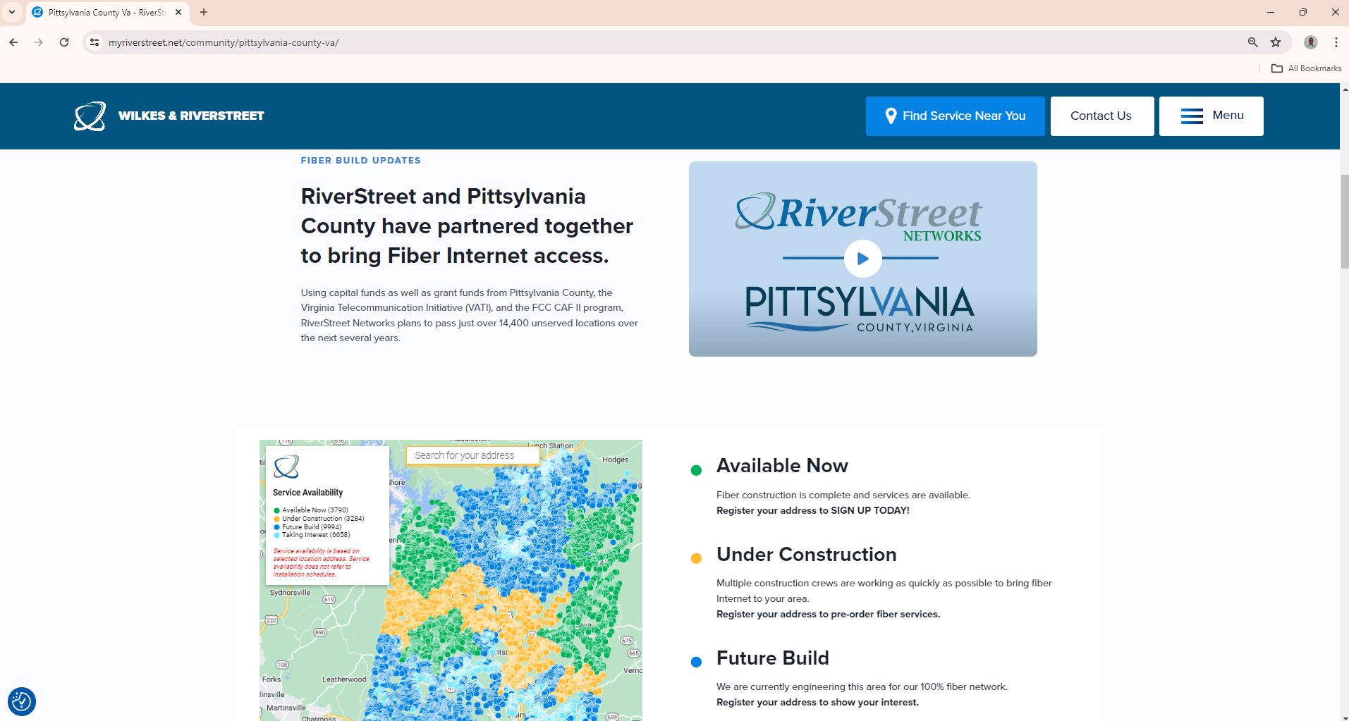
QUESTIONS?
https://myriverstreet.net/community/pittsylvania-county-va/

Slide 7
QUESTIONS?

