Slide 1
ROB TAYLOR - DIRECTOR OF BUSINESS DEVELOPMENT & GOVERNMENT AFFAIRS PITTSYLVANIA COUNTY FTTH UPDATE APRIL 16, 2024

Slide 2
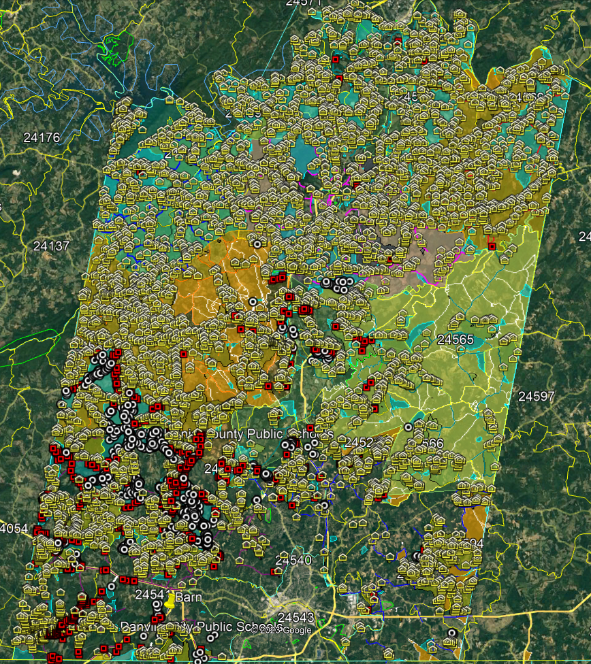
PITTSYLVANIA COUNTY – CAF II & VATI APPLICATION LOCATIONS
CAF II & VATI APPLICATION LOCATIONS PASSED BY RSN FTTH PLAN
RSN RDOF – 8,369
UNFUNDED – 3,616
VATI 2022 TOTAL - 11,985
VATI 2023 TOTAL - 2,102
CAF II - 2,412
GRAND TOTAL - 16,499
CAF AWARD PROJECT AREA
RDOF & VATI 22 LOCATIONS
VATI 23 LOCATIONS NEW FIBER
VATI 23 LOCATIONS EXISTING FIBER

Slide 3
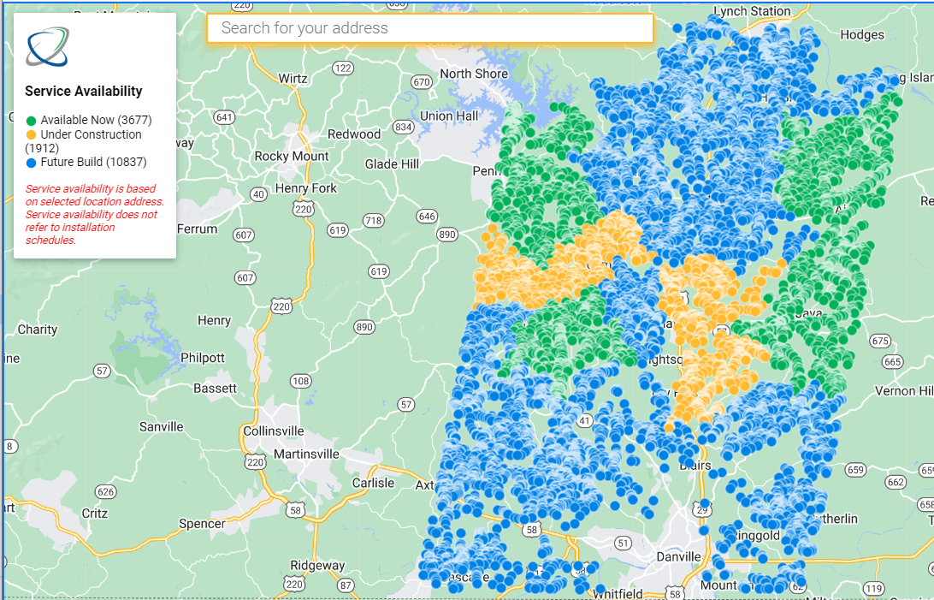
CURRENT SERVICE MAP

Slide 4
PITTSYLVANIA GENERAL INFORMATION
As of Thursday, 04/11/2024 we had 384 customers installed which is an increase of 131 locations since our last reporting
Currently have 129 orders in process
Since our last reporting the number of locations passed has increased 912 locations to 3,677
This puts us at a14% take rate based locations passed & orders placed and/or completed
Ringgold is the only remaining building to be installed in the County at this time. We have Whites construction bringing in fill dirt to level site and place a culvert for the driveway to the site.
Power was installed by MEC at Strawberry Datahut
772 of the locations being fed by this Datahut now have access to service
We are working with our marketing department to begin marketing efforts in areas that are about to be activated to provide brand awareness and information about plans and services provided sooner hoping speed up the connection process.
We are also looking at new processes to ensure speedy connections. We are facing difficulties with getting locates completed across the State and hoping we can get ahead of the issue.

Slide 5
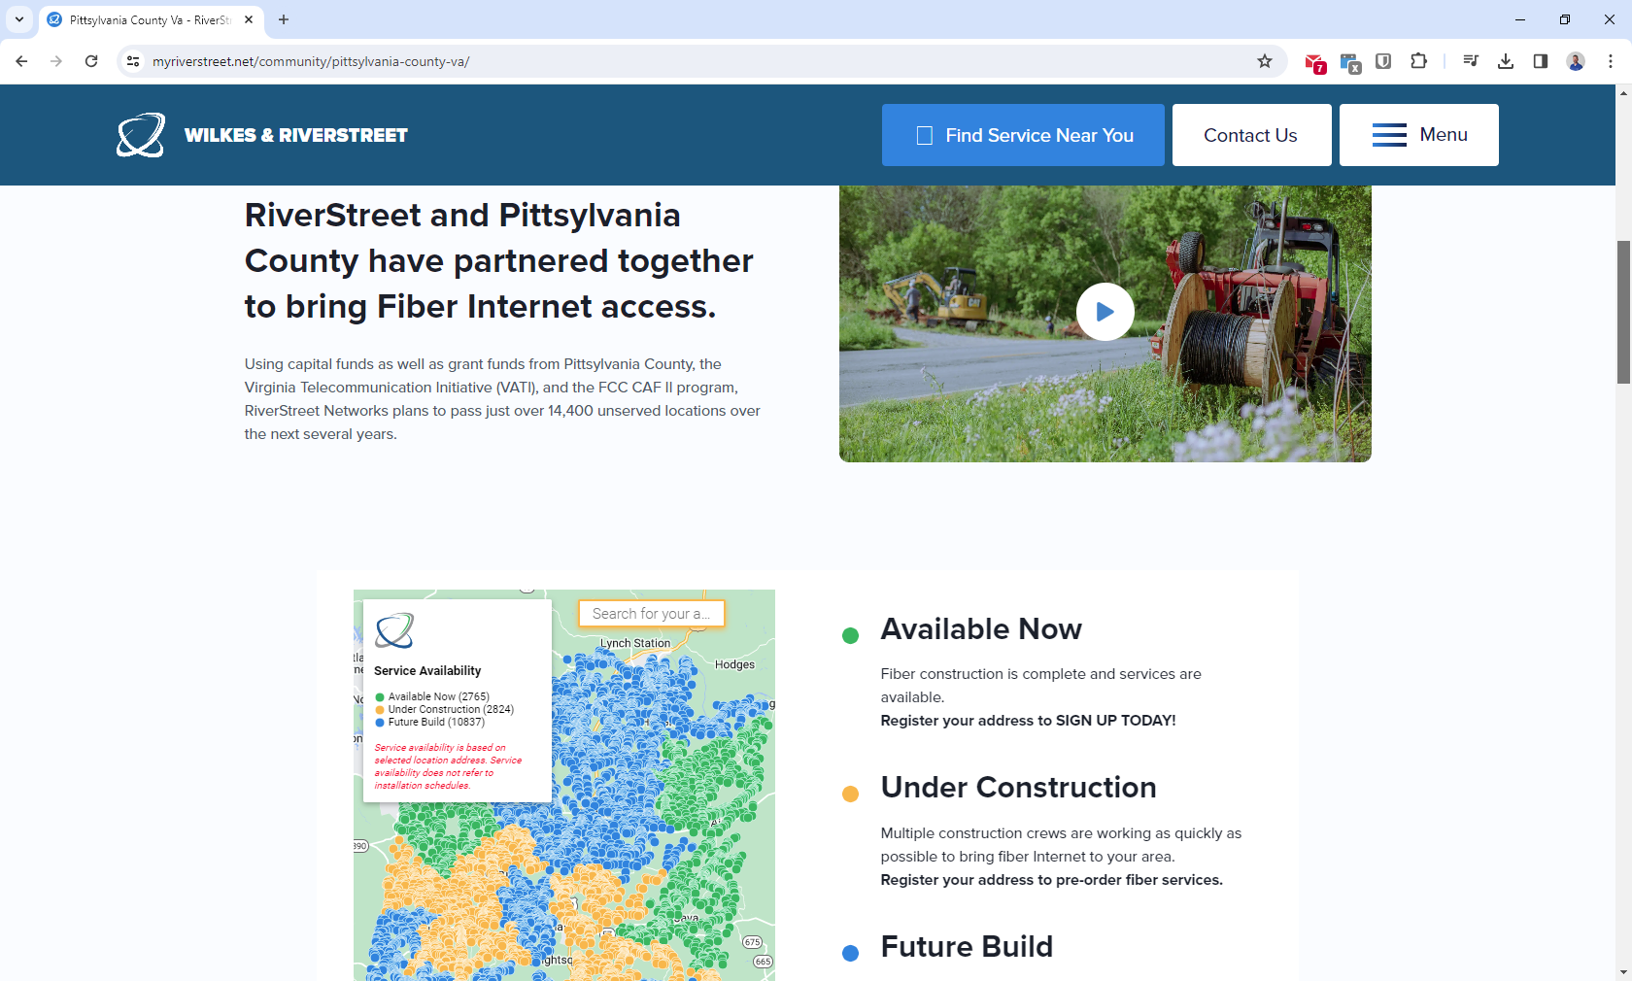
QUESTIONS?
https://myriverstreet.net/community/pittsylvania-county-va/

Slide 6
QUESTIONS?

