Slide 1
Special Meeting
County Administrator’s Recommended Budget
March 12, 2024

Slide 2
FY24-25 Budget Overview
In accordance with Virginia Code 15.2-1541, 2503, I present to you the County Administrator’s FY 2024-2025 recommended budget for Pittsylvania County, Virginia. This $239,161,887 budget is 2.7% more than the FY2024 budget of $232,916,421, due primarily to the addition of the new 1% Sales Tax Revenue for Schools, and increased local funding for Schools and Long -Term Capital Items. This budget sets us up for success today and going forward, with both immediate and long-term integrity.
The core General Fund budget of $87,859,483 is an increase over this year’s budget by 10%. The largest increases are for Sheriff/Corrections and Detention ($1,129,206), Volunteer Fire Departments ($836,707), School Board Transfer ($2,535,639) and Capital Improvement Fund Transfer ($2,452,360). Fire & Rescue receives an additional $669,000 in capital outlay this year.
The increase is supported by increased real estate values, resulting from the recent reassessment. The increase allows to adjust the tax rate down from 62¢ to 59¢, to offer some tax rate reduction, while providing the quality of services expected of us by our citizens. No other changes to fees or tax rates are in this budget.
We need to go ahead and approve this recommended budget and tax rate for advertisement today, to stay on our Budget calender schedule.

Slide 3
Budget Challenges
No one wants more taxes, particularly with the recent increase in property values. The Staff goal was to examine the budget requests for the level of service demanded by our citizens, now and going forward, then lower the tax rate to that level, which is a 3 Cent reduction. Requests were $10.1 million; we cut nearly $2 million out of the budget: we cut or reduced all non-essential requests. No wish list allowed!
This year’s budget began with a $2 million deficit (due to increased costs the last 6 years, with no corresponding tax increase). These costs caught up with us this year, requiring a $2,000,000 transfer from Solid Waste fund balance to fill the gap in the General Fund. This year, we need to match ongoing revenues with ongoing costs and not use fund balance. As with any business, we must operate and pay the bills, as an ongoing organization with payroll, equipment, fuel costs, within the limits of current revenues.
We have long-term multi-million $$ capital projects with the new Jail, renovations to Historic buildings, a future Courthouse complex, among others. We need to plan for the long term and not just today! For instance, this year we establish a Debt Reserve fund, to plan for these costs down the road.
The State contribution to Schools was reduced due to the increased local composite index, which we must cover as per Standard of Quality Requirements. The last two years we gave Schools 6% above the base SOQ standard and recommend doing so again, to maintain the high standard of our schools, whose scores rank well above our surrounding school systems, and as high as the top 12% in the State.

Slide 4
Forward-Looking Strategic Goals Achieved with This Budget Recommendation
This budget recommendation allows us to catch up to the 6 years of increased expenses, then propels us forward to build a stronger community in the future, by:
Providing more funding to public safety (Sheriff, Fire-Rescue), building more capacity in the system, for a safer community
Staying on track with new Jail project timeline
Providing sufficient school funding for continued upward academic excellence
Supporting economic development to provide good paying jobs and create wealth in the community
Continuing our solid financial position, maintaining strong fund balance, with a new Debt Reserve fund
Keeping pace with inflation in costs, without the use of fund balance, by matching revenues and expenses
Funding immediate and long-term capital needs including Volunteer Fire-Rescue equipment
Funding vital positions/equipment to maintain and improve the organization’s customer service levels
Providing adequate employee compensation to recruit and retain the best
Managing the new 1% School Sales Tax Fund to improve and revitalize school infrastructure
Developing Quality of Life improvements such as new Recreation and outdoor activities
Protecting our historical agricultural roots, while planning for future housing needs, with an updated Comprehensive Land Use plan, to include a strong affordable Housing policy.

Slide 5
FY 2025 Revenue Projections
Reassessment- Value increased on average 48%
Value of Property: $6.2B
Tax Value at current 62¢ rate: $36.5M
Additional Revenue at this rate: $10.1M

Slide 6
FY2025 – Budget funded with 59¢ RE Tax Rate
A 59¢ Real Estate Tax Rate will provide an additional $8.3M in Revenue
A total of $1.842M has been removed from the budget to get bring expenditures in line with revenues

Slide 7
Budget Updates
Pittsylvania County Schools
Current State Budget Proposals
Local Required Effort

Slide 8
Budget Updates
Pittsylvania County Schools
Current Budget Proposal
Presented to the PCS Budget Committee on March 7, 2024
3% COLA for contract employees
Minimum Wage adjustment for all Support Staff as of July 1, 2024, and for substitutes as January 1, 2025
Operating increases for Maintenance and Transportation supplies and services
Two software needs from Information Technology
4 Athletic Directors for our Middle/High Schools
This budget requires a total Local Contribution from Pittsylvania BOS of $25,313,792, an increase of $3,217,436 over the FY2024 contribution.

Slide 9
Budget Updates
Pittsylvania County Schools
Current Budget Proposals
Since we currently do not know the outcome of the State budget, the PCS budget was based on the current Governor’s budget with a few adjustments. The Governor’s budget included a 1% bonus payment while the other two versions included a 3% COLA. This change would result in a local required effort of $23,237,731.
An additional 6% on this figure would result in a PCS contribution of $24,631,995, an increase of $2,535,639 over the prior year contribution.

Slide 10
FY2025 – Budget funded with 59¢ RE Tax Rate
What is currently funded in this Budget
All new requested positions-TOTAL COST $689,677 – This would fully fund a new ambulance station at 640.
3% COLA for all County employees on the County’s pay plan-TOTAL COST $670,000
Sheriff’s Department-Year 2 of Vehicle Lease (20 Vehicles)-Year 1 funded with Carryover Funds-TOTAL COST $213,956.

Slide 11
FY2025 – Budget funded with 59¢ RE Tax Rate
What is currently funded in this Budget
Fire & Rescue Shared Costs-TOTAL COST $256,600
EMS SVC Contracts-Equipment - $212,800
Vehicle Insurance - $35,000
Training - $5,000
EMS-OMD – ($1,200)
Software Support Expense – $5,000
Fire & Rescue Volunteer Operating Increase-TOTAL COST $227,600
Base Funding Increased from $26,500 to $31,800 (20% raise)-TOTAL COST $169,600
Fire Service Contracts - $48,000
Line of Duty Insurance - $10,000

Slide 12
FY2025 – Budget funded with 59¢ RE Tax Rate
What is currently funded in this Budget
New Community Contributions – TOTAL COST $264,410 (included additional funding for Public and Mental Health)
Pittsylvania County School Funding to meet Local Required Effort – TOTAL COST $2,535,639
New Capital Projects – TOTAL COST $3,150,000
GRAND TOTAL OF MAJOR INCREASES $8M

Slide 13
Capital Budget
Computer Capital Outlay - $136,547 (HR On-Boarding, Community Development Public Access, and Telephone System Upgrade)
Building & Grounds Capital Outlay - $340,000 (Emergency Repairs Fund)
Fire & Rescue Capital Outlay - $1,270,000 (Drug Box Requirement, PPE, Medical and Training Equipment, Volunteer Radio Upgrade, 2 Volunteer Fire Engines (increased contribution of $25K each), 2 Volunteer Ambulances (increased contribution of $25K each), Career Staff Ambulance)
Community Development Outlay - $1,979,493 (Comprehensive Plan, Moses Building Renovations, Voting Equipment (Year 1), Library-Bookmobile (Downpayment)
Recreation Capital Outlay - $40,250 (Tractor for Wayside Park, School Facility Use Fee)
GRAND TOTAL – ALL CAPITAL $3,766,290

Slide 14
Budget Updates
Changes since March 5, 2024
Contribution to Schools – Increased $360,639
Community Contributions – Reduced $90,000
Contingency/Grant Local Match – Increased $75,000 – Summer Intern Program discontinued for FY 2025
All new positions discussed last Tuesday are currently funded – No cuts made
All Capital items discussed last Tuesday are currently funded – No Cuts made

Slide 15
Budget Updates-TOTAL CHANGES

Slide 16
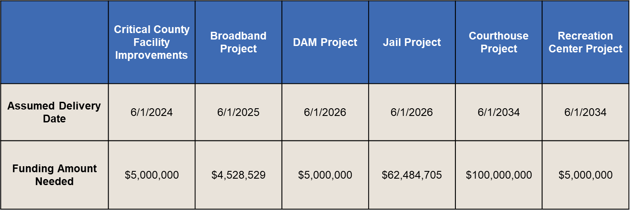
Long Term Capital Needs

Slide 17
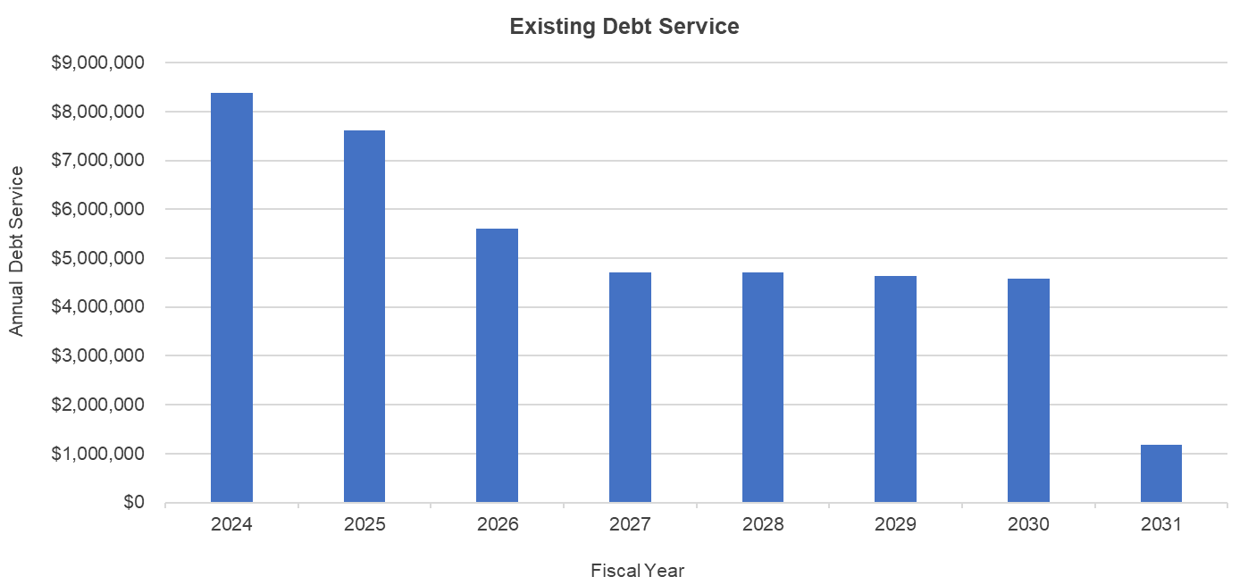
Long Term Capital Needs
Currently, the County has a modest amount of debt outstanding, totaling $31 million. Annual debt service range from $1.2 million to $8.4 million, with final maturity in FY 2031. With debt service falling off, we are proposing to use the surplus for a long-term Debt Reserve fund for large capital projects upcoming such as Jail and Courthouse complex.

Slide 18
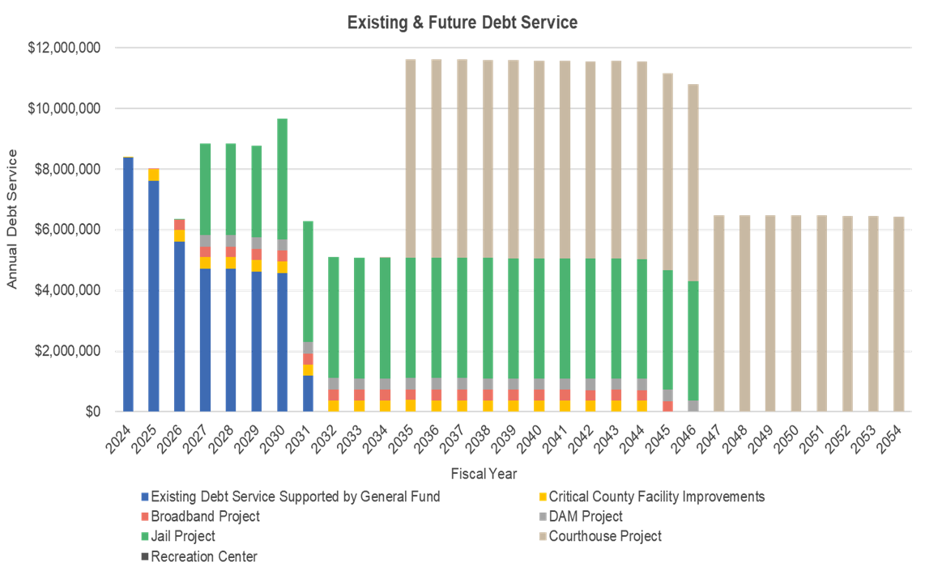
Long Term Capital Needs

Slide 19
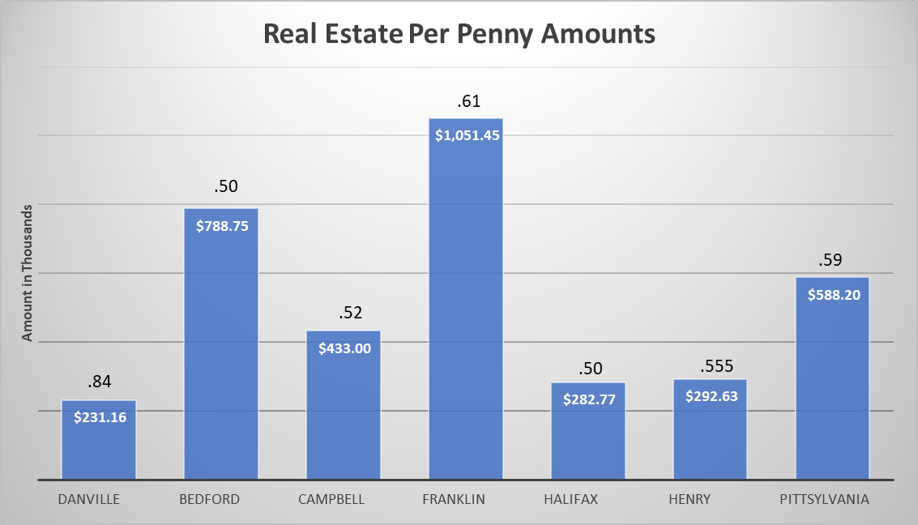
Historical Data for all localities – Only Pittsylvania adjusted for New Reassessment

Slide 20
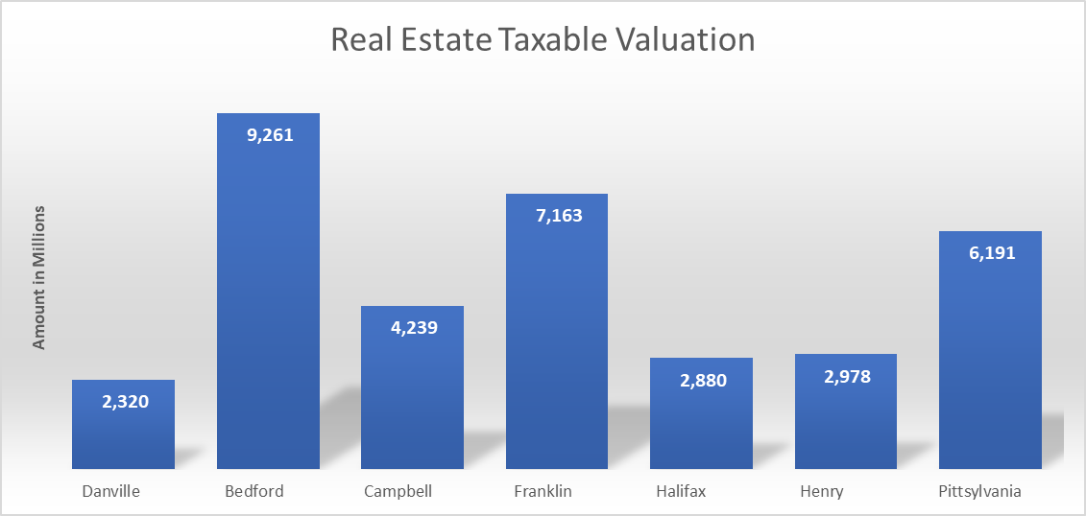
Historical Data for all localities – Only Pittsylvania adjusted for New Reassessment

Slide 21
Discussion Topic: Tax Rate Relief

Slide 22
Tax Rate to Balance the Budget for Today and the Future
This budget recommends a tax rate of 59¢, which is the balanced budget which we present to you now. This rate allows us to do the new things we mentioned above to strengthen the organization and impact the community for 2025 and will allow for some growth over the following 3 fiscal years, including a Debt Reserve fund for our large capital items such as the jail and courthouse, new Recreation possibilities, more Sheriff, Fire-Rescue and School funding, and continued funding for operational capital items needed to function day-to-day such as Sheriff patrol vehicles, computer equipment and fire-rescue SCBA/personal protection equipment.
We ask that you approve this recommended budget and tax rate for advertisement.

Slide 23
Effect of 59-cent tax rate on properties of different values Based on average property value increase of 48% due to 2024 reassessment
Value before: $125,000 = $775 per year or $64.58 a month
Value after: $185,000 = $1,091.50 per year or $90.95 a month
Difference: $316.50 per year or $26.37 a month
Savings per penny: $18.50
Value before: $150,000 = $930 per year or $77.50 a month
Value after: $222,000 = $1,309.80 per year or $109.15 a month
Difference: $379.80 per year or $31.65 a month
Savings per penny: $22.20
Value before: $200,000 = $1240 per year or $103.33 a month
Value after: $296,000 = $1,746.40 per year or $145.53 a month
Difference: $506.40 per year or $42.20 a month
Savings per penny: $29.60

