Slide 1
Finance Committee Meeting
February 20, 2024

Slide 2
FY24-25 Budget Overview
The goal of this year’s budget is to provide the level of service that our citizens expect of us and to plan for future growth, at a tax rate adjusted for the large increase in property values.
Staff reviewed all department requests, making reductions to the requests based on actual, not desired, use. No wish list!
Therefore, this budget is as lean as we can make it.
Every tax dollar has a higher standard and must be justified as a needed cost!
No one wants more taxes! This budget will be a balance between that understanding and what is expected of us TO DO for this community, now and going forward.

Slide 3
Budget Challenges
Reminder: we started this year’s budget with a $2M budget deficit and must be able to operate and pay the bills as an ongoing organization with payroll, equipment, fuel, etc.
Costs have increased significantly over the last 6 years but there has been no reassessment or tax increase to cover them in that period.
The County faces new long-term multi-million $$ capital projects with the Jail, renovations to the Historic buildings, a future Courthouse complex, among others. We need to plan for the long term and not just today!
The State contribution to Schools was reduced by $900,000, due to the increased local composite index, which we are required to cover as per Standard of Quality Requirements.

Slide 4
FY 2024 Revenues

Slide 5
FY 2025 Revenue Projections
Estimates currently being used for revenue projections are based on historical data. We will not have confirmed figures for the major sources of revenue until month-end.
Reassessment- Value increased on average 48%
Value of Property: $6.2B
Tax Value at current 62¢ rate: $36.5M
Additional Revenue at this rate: $10.1M

Slide 6
Operating Budget
Budget Requests total $10M more than last year’s adopted GF Budget
3% COLA has been included for County employees under the County’s Pay Plan as well as funds to cover minimum wage increase to $13.50 effective January 1, 2025 – TOTAL INC $670K
Requests include new positions-TOTAL INC $746K
7 Full-time Positions: 1-Information Technology 4-Public Safety 1-Recreation 1-Community Policy and Management Team (CPMT)
1 Part-time Position 1-Library
3 Part-time to Full-Time 1-Registrar 2-E911

Slide 7
Operating Budget
Sheriff: Increase to Overtime due to workforce shortage-TOTAL INC- $118K New Lease for 20 vehicles started in FY2024 with Carryover Funds- TOTAL INC- $214K Increases new SRO Positions-$162K Increase for Local Match to SRO and other Grants-$350K
Fire/EMS: Matrix Base increase for Volunteer Agencies-TOTAL INC- $184K EMS Supplement-Per Call increase to $50-TOTAL INC-$205K Fire Response-Per Call-New Request-TOTAL INC-$60K Equipment Maintenance-EMS-TOTAL INC-$212K Equipment Maintenance-FIRE-TOTAL INC-$179K

Slide 8
Operating Budget
Schools: Amount included in this budget is based on Required Local Effort (RLE) amount listed in the Governor’s Proposed FY2025 Budget plus an additional 6% over the RLE-TOTAL INC $2.175M. This is not a final amount since we still do not have the House nor Senate version of the FY2025 Budget. This figure will most likely increase
Capital Contribution included in this budget TOTAL INC $4.5M. Staff is recommending the elimination of $930K from these requests.

Slide 9
Capital Budget
Computer Capital Outlay Totals $136.5K: Software Upgrades for HR Onboarding, Telephone Upgrade, and Community Development On-line Portal for Building Permits
Building & Grounds Capital Outlay Totals $440K: Building & Grounds Improvement Emergency Fund-$340K Space Needs Study-$100K (Recommended by Staff to Eliminate)
Fire & Rescue Capital Outlay Totals $1.370M: Apparatus Increases for Volunteer Fire and Rescue-$50K per Vehicle Fire Trucks-Increase from $200K to $250K Ambulances-Increase from $125K to $175K Purchase of EMS Building in Blairs-$680K (Recommended by Staff to Eliminate) Drug Box Requirement-$70K Career Ambulance-$250K Radio Upgrade-$180K (Year 2 of 3 Year Upgrade)

Slide 10
Capital Budget
Departmental/Community Capital Outlay Totals $2.2M : Moses Building Renovations-$1.5M Comprehensive Plan Upgrade-$150K (Grants to possibly Fund Remainder) Voting Equipment Purchase-$375K (187.5K will be cut ) Bookmobile Purchase-$100K (Grants to possibly Fund Remainder)
Recreation Capital Outlay Totals $40K: Tractor for Wayside Park-$25K Facility Lease-Schools-$15K

Slide 11
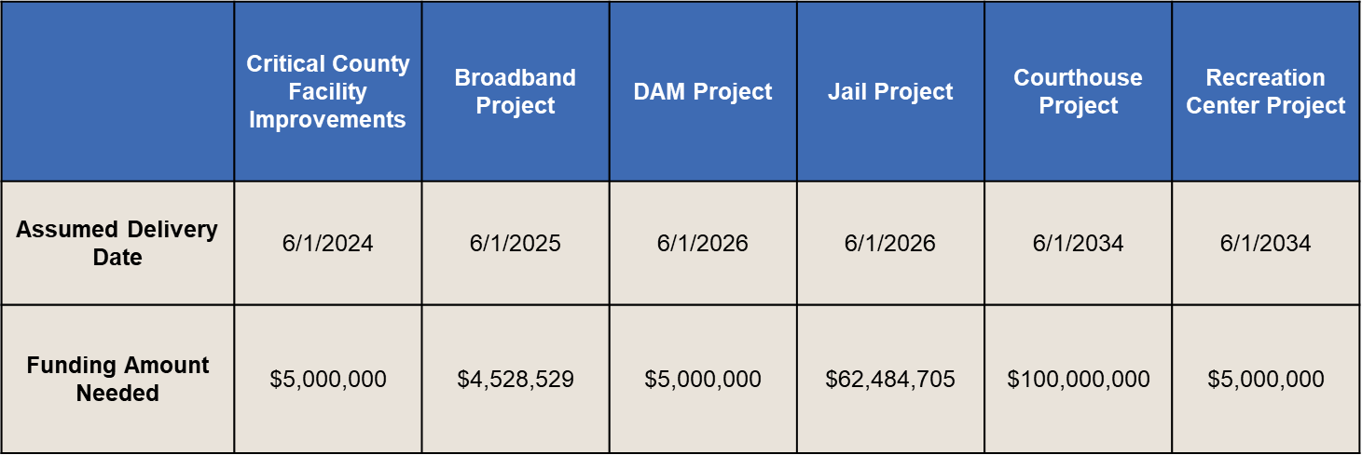
Long Term Capital Needs

Slide 12
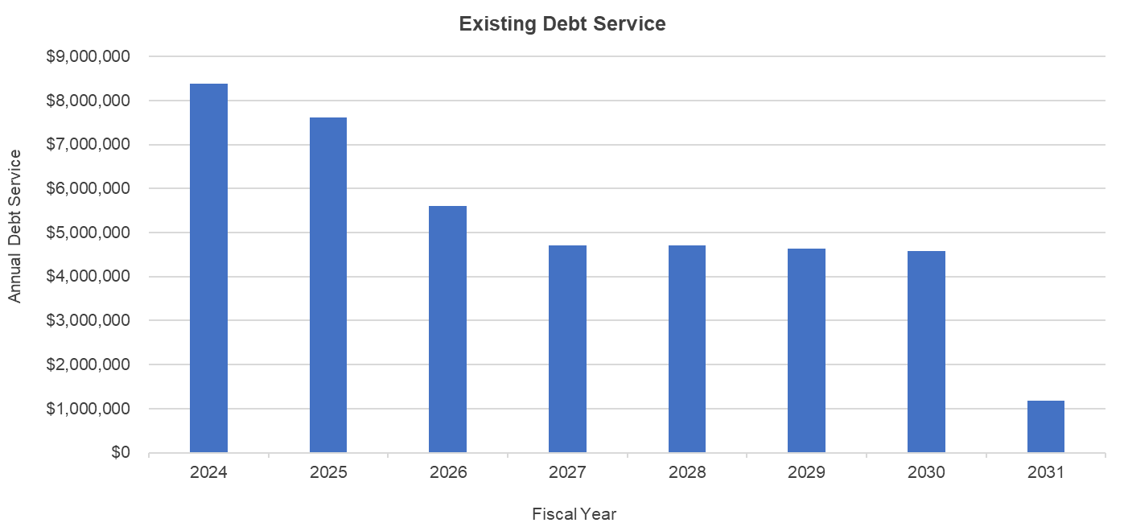
Long Term Capital Needs
Currently, the County has a modest amount of debt outstanding, totaling $31 million. Annual debt service range from $1.2 million to $8.4 million, with final maturity in FY 2031.

Slide 13
Tax Rate Relief
We recommend lowering the tax rate to 59¢. This rate would allow us to cover current budgetary needs for FY 2025 and will allow for some growth over the following 3 fiscal years.
A typical Single-Family Residence with a current property value of $200,000 would increase to $296,000 based on the average 48% increase. The effect of this tax rate will cost this taxpayer an additional $506.40 in tax over last year. This equates to $42.20 per month.
Recall that one cent of taxes is $588,000. To reduce the tax rate further would require reductions of this amount for each cent reduced.
We invite your Comments and Thoughts?

