Slide 1
Zack Church – Director of OSP Engineering and Construction
Scotty Bare - Field Engineer PITTSYLVANIA COUNTY FTTH UPDATE – September 19, 2023

Slide 2
PITTSYLVANIA COUNTY
FTTH OVERVIEW

Slide 3
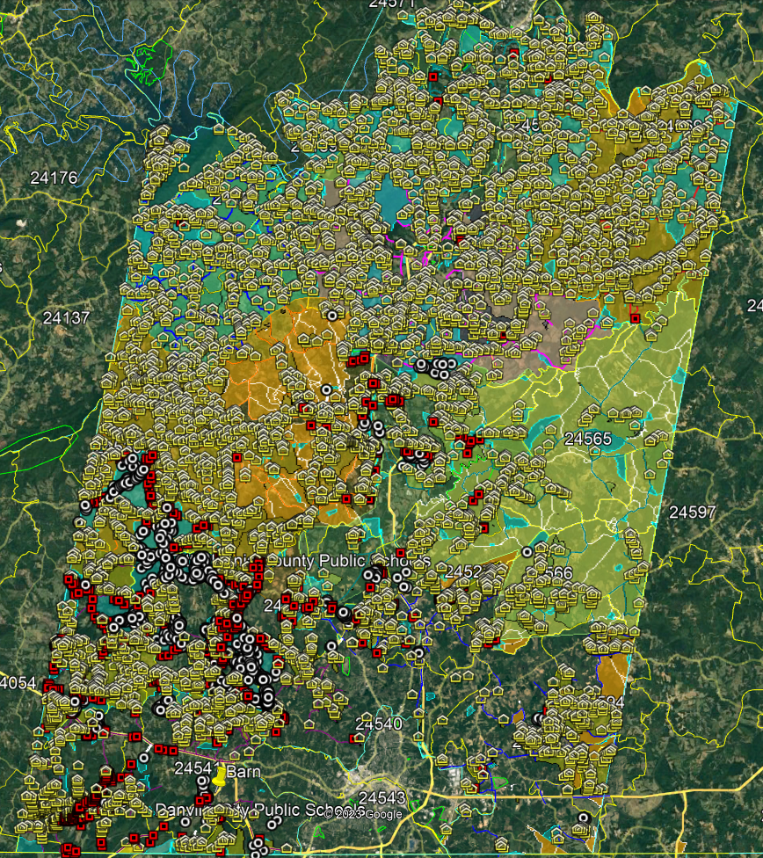
PITTSYLVANIA COUNTY – CAF II & VATI APPLICATIONS LOCATIONS
CAFF II & VATI APPLICATION LOCATIONS PASSED BY RSN FTTH PLAN
RSN RDOF – 8,369
UNFUNDED – 3,616
VATI 2022 TOTAL - 11,985
VATI 2022 TOTAL - 2,105
CAF II - 2,412
GRAND TOTAL - 16,502
CAF AWARD PROJECT AREA
RDOF & vati 22 lOCATIONS
VATI 23 LOCATIONS NEW FIBER
VATI 23 LOCATIONS EXISTING FIBER

Slide 4
PITTSYLVANIA COUNTY CAF II
Federal Funds - CAF II | $4,056,552 | 39.8%
Federal Funds - ARP | $0 | 0.0%
State Funds - VATI | $0 | 0.0%
Local Funds Phase | $0 | 0.0%
RSN Matching Funds - Cash / Loan | $6,125,940 | 60.2%
 | $10,182,492 | 100.0%
PITTSYLVANIA COUNTY VATI 2022 APPLICATION
Federal Funds –RDOF I (years 1 -3) | $2,301,619 | 3.0%
Local Funds – ARP | $16,528,939 | 21.8%
State Funds - VATI | $39,510,529 | 52.2%
RSN Matching Funds – RDOF 1 (years 4 – 10) | $5,370,445 | 7.1%
RSN Matching Funds – Installation (40% Take) | $11,985,000 | 15.9%
 | $75,696,532 | 100.0%

Slide 5
PITTSYLVANIA COUNTY VATI 2023 APPLICATION
State Funds - VATI | $3,548,250 | 65.6%
Local Funds Phase | $0 | 0.0%
RSN Matching Funds - Cash / Loan | $1,856,750 | 34.4%
 | $5,405,000 | 100.0%
PITTSYLVANIA COUNTY TOTAL FTTH PROJECT
Federal Funds – CAF II & RDOF I (years 1 -3) | $6,358,171 | 7.0%
Local Funds – ARP | $16,528,939 | 18.1%
State Funds - VATI | $43,058,779 | 47.2%
RSN Matching Funds – RDOF 1 (years 4 – 10) | $5,370,445 | 5.9%
RSN Matching Funds – Installation (40% Take) | $19,967,690 | 21.8%
 | $91,284,024 | 100.0%

Slide 6
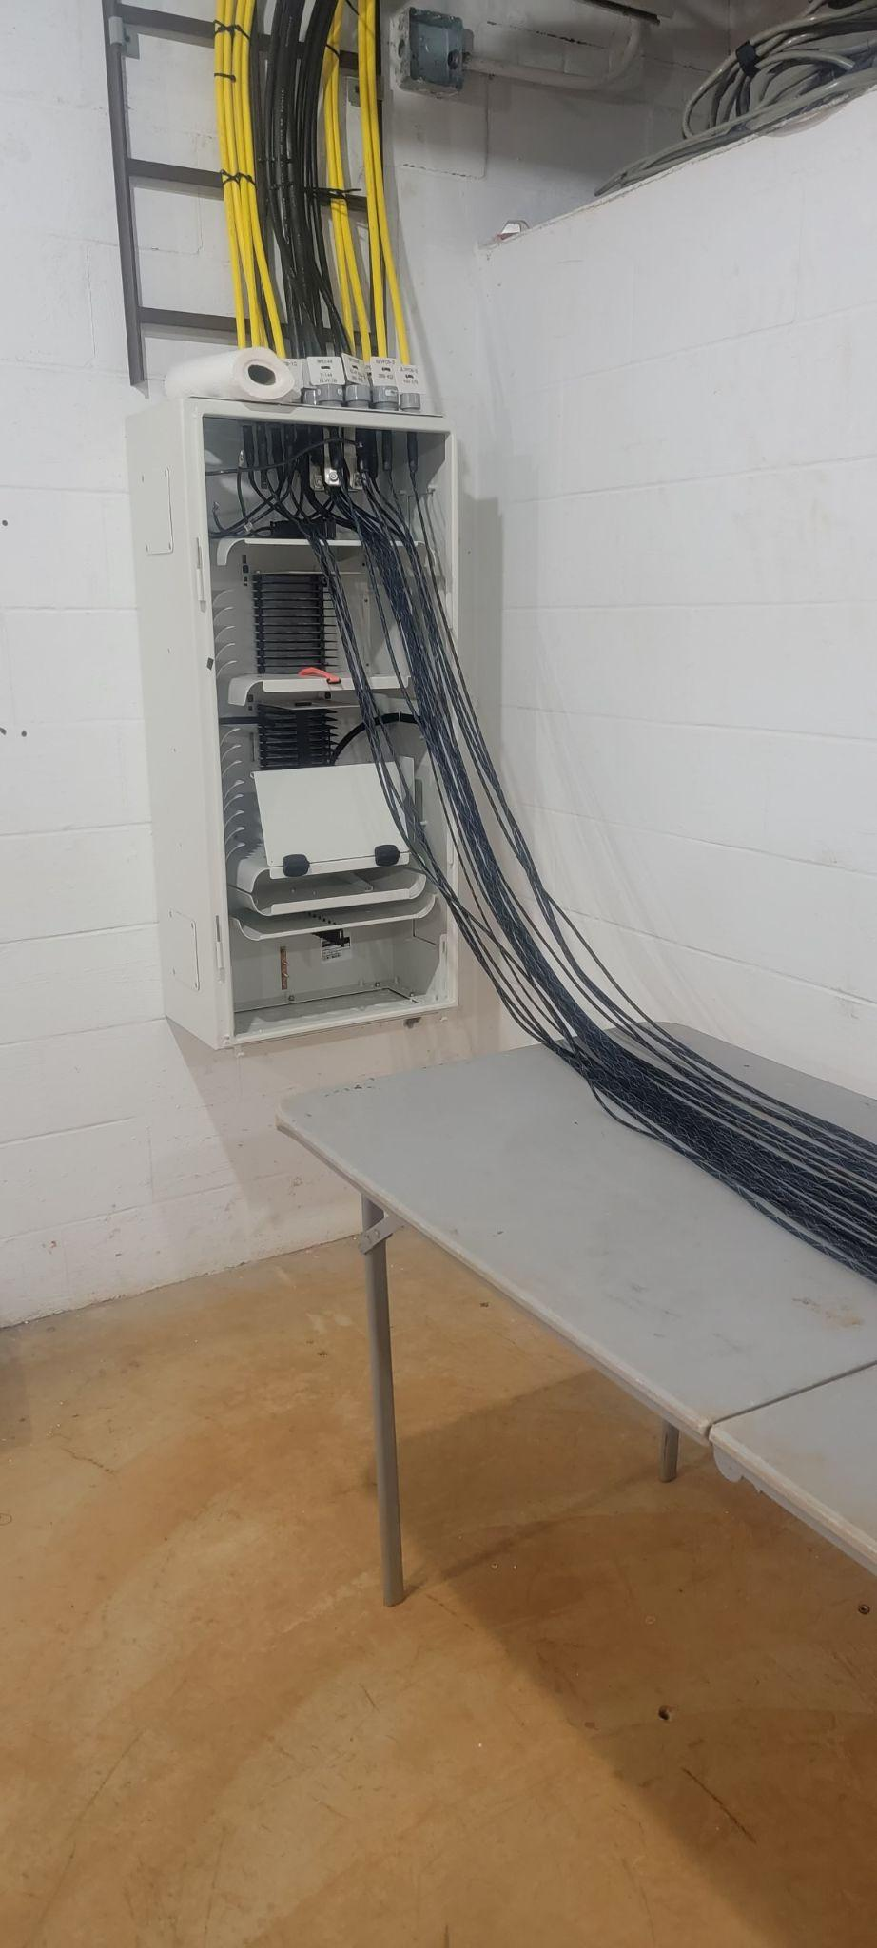
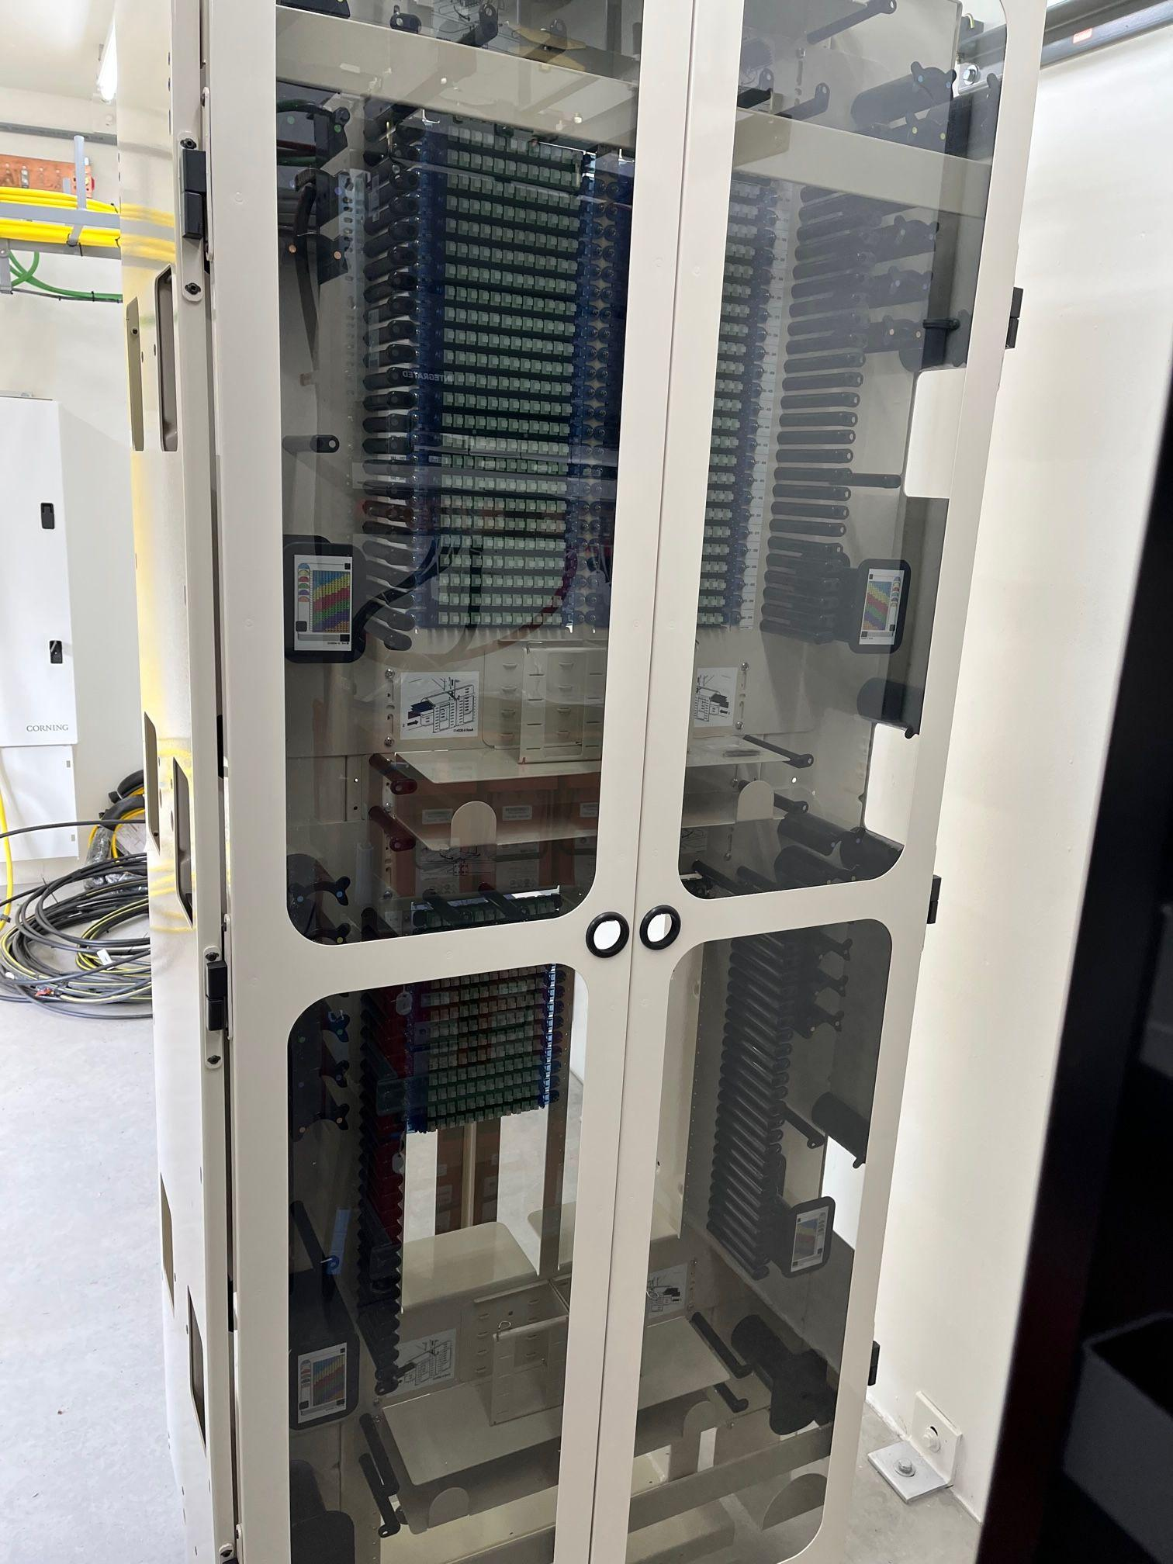
Fiber racks and OSE cabinet are here and installed in Sandy Level.
7 additional remote racks and cabinets are here as well.
Fiber yet?

Slide 7
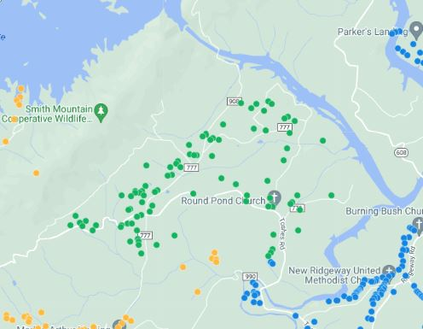
Fiber yet?
Currently we have 88 homes that can get connected!
We have connected homes!
We have 227 orders in que.

Slide 8
PITTSYLVANIA COUNTY
FTTH UPDATE

Slide 9
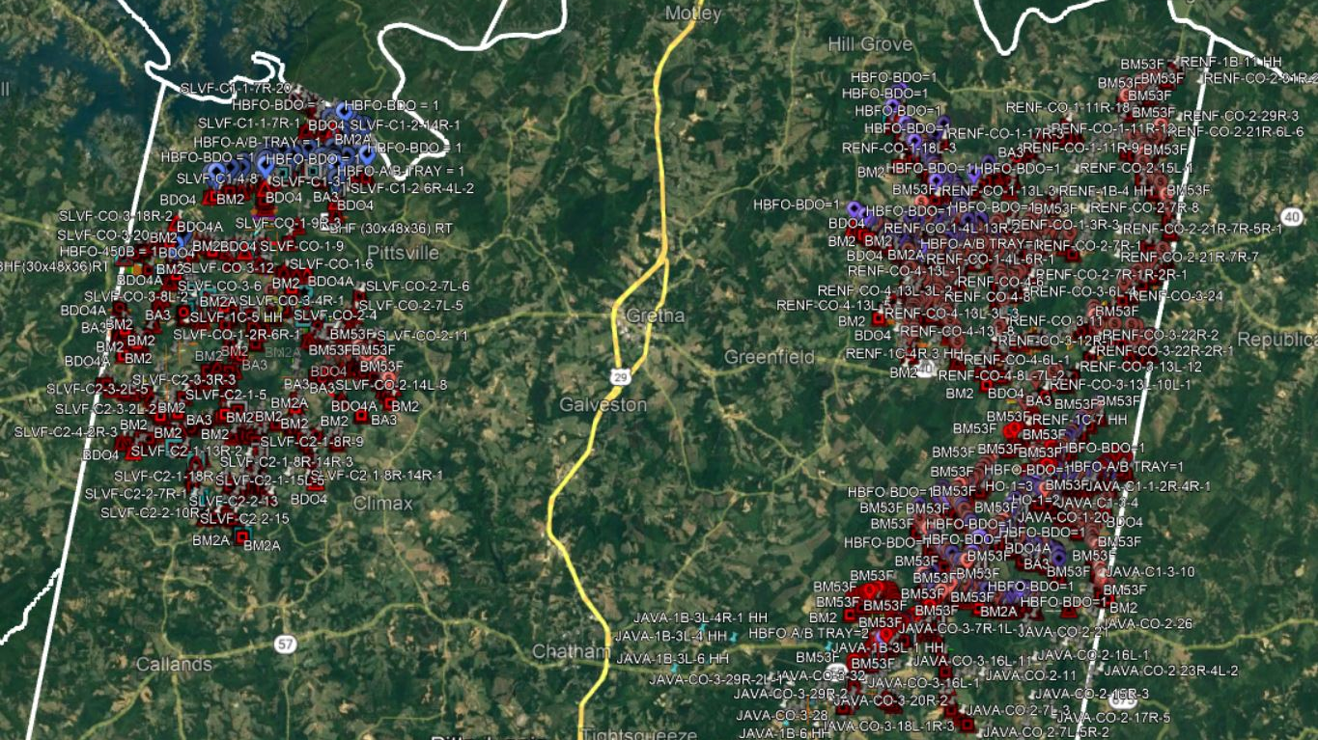

Slide 10
SANDY LEVEL CONSTRUCTION
6/20/2023 |  |  |  |  |  |  |  | 9/19/2023
Sandy Level |  |  |  |  | Difference |  |  | Sandy Level
Statistics | Contract | Current | Completion |  |  |  |  | Statistics | Contract | Current | Completion
Total Cable Ftg | 638,828 | 299,948 | 46.95% |  | 224,308 | 35.11% |  | Total Cable Ftg | 638,828 | 524,256 | 82.07%
Total Route Ftg | 486,426 | 211,401 | 43.46% |  | 184,618 | 37.95% |  | Total Route Ftg | 486,426 | 396,019 | 81.41%
Total Drill Ftg | 55,728 | 45,932 | 82.42% |  | 11,713 | 21.02% |  | Total Drill Ftg | 55,728 | 57,645 | 103.44%
Total Peds | 466 | 207 | 44.42% |  | 162 | 34.76% |  | Total Peds | 466 | 369 | 79.18%
Total Vaults | 30 | 36 | 120.00% |  | 21 | 70.00% |  | Total Vaults | 30 | 57 | 190.00%
Total PON Cabinets | 2 | 1 | 50.00% |  | 0 | 0.00% |  | Total PON Cabinets | 2 | 1 | 50.00%

Slide 11
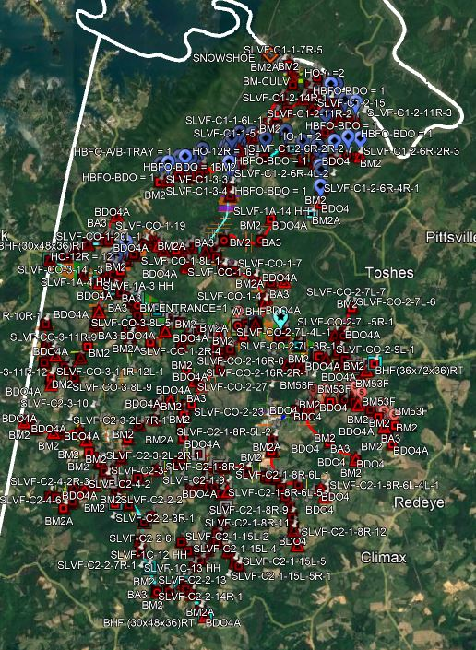
SANDY LEVEL
AS BUILT

Slide 12
RENAN CONSTRUCTION
6/20/2023 |  |  |  |  |  |  |  | 9/19/2023
Renan |  |  |  |  | Difference |  |  | Renan
Statistics | Contract | Current | Completion |  |  |  |  | Statistics | Contract | Current | Completion
Total Cable Ftg | 561,350 | 12,662 | 2.26% |  | 352,382 | 62.77% |  | Total Cable Ftg | 561,350 | 365,044 | 65.03%
Total Route Ftg | 449,450 | 12,662 | 2.82% |  | 298,702 | 66.46% |  | Total Route Ftg | 449,450 | 311,364 | 69.28%
Total Drill Ftg | 65,273 | 2,936 | 4.50% |  | 53,611 | 82.13% |  | Total Drill Ftg | 65,273 | 56,547 | 86.63%
Total Peds | 453 | 19 | 4.19% |  | 299 | 66.00% |  | Total Peds | 453 | 318 | 70.20%
Total Vaults | 28 | 4 | 14.29% |  | 19 | 67.86% |  | Total Vaults | 28 | 23 | 82.14%

Slide 13
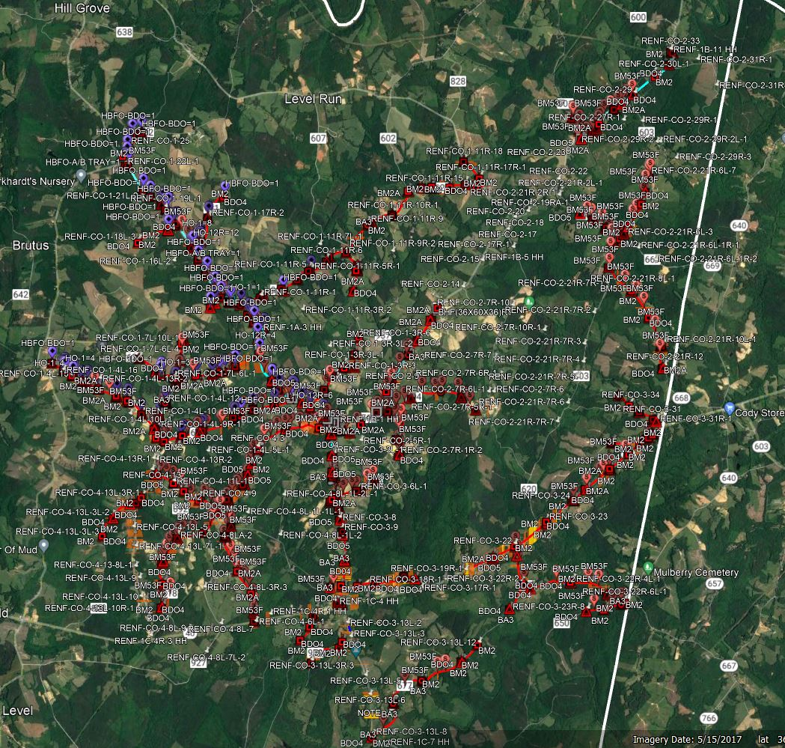
RENAN
AS BUILT

Slide 14
JAVA CONSTRUCTION
6/20/2023 |  |  |  |  |  |  |  | 9/19/2023
Java |  |  |  |  | Difference |  |  | Java
Statistics | Contract | Current | Completion |  |  |  |  | Statistics | Contract | Current | Completion
Total Cable Ftg | 861,616 | 95,902 | 11.13% |  | 193,244 | 22.43% |  | Total Cable Ftg | 861,616 | 289,146 | 33.56%
Total Route Ftg | 753,348 | 74,520 | 9.89% |  | 164,260 | 21.80% |  | Total Route Ftg | 753,348 | 238,780 | 31.70%
Total Drill Ftg | 50,936 | 5,224 | 10.26% |  | 9,389 | 18.43% |  | Total Drill Ftg | 50,936 | 14,613 | 28.69%
Total Peds | 820 | 87 | 10.61% |  | 152 | 18.54% |  | Total Peds | 820 | 239 | 29.15%
Total Vaults | 43 | 13 | 30.23% |  | 11 | 25.58% |  | Total Vaults | 43 | 24 | 55.81%
Total PON Cabinets | 5 | 0 | 0.00% |  | 1 | 20.00% |  | Total PON Cabinets | 5 | 1 | 20.00%

Slide 15
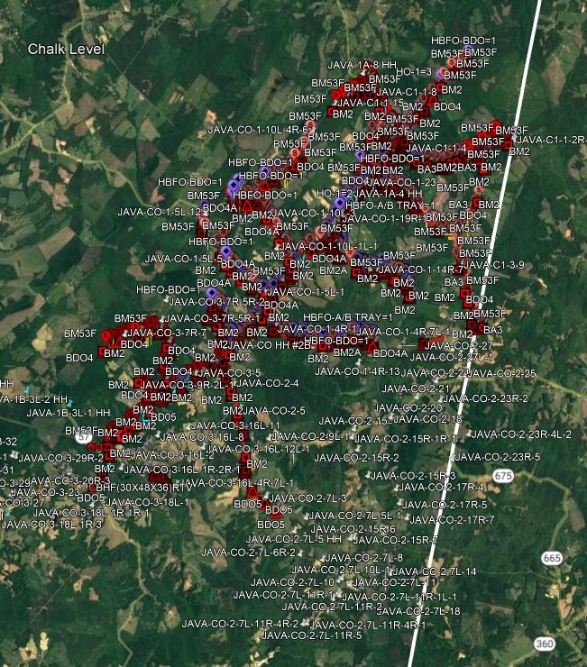
JAVA
AS BUILT

Slide 16
lAKESIDE CONSTRUCTION
6/20/2023 |  |  |  |  |  |  |  | 9/19/2023
 |  |  |  |  | Difference |  |  | Lakeside
 |  |  |  |  |  |  |  | Statistics | Contract | Current | Completion
 |  |  |  |  | 0 | 0.00% |  | Total Cable Ftg | 104,706 | 0 | 0.00%
 |  |  |  |  | 0 | 0.00% |  | Total Route Ftg | 85,092 | 0 | 0.00%
 |  |  |  |  | 7,302 | 23.14% |  | Total Drill Ftg | 31,551 | 7,302 | 23.14%
 |  |  |  |  | 0 | 0.00% |  | Total Peds | 295 | 0 | 0.00%
 |  |  |  |  | 0 | 0.00% |  | Total Vaults | 10 | 0 | 0.00%
 |  |  |  |  | 0 | 0.00% |  | Total PON Cabinets | 3 | 0 | 0.00%

Slide 17
Overall Construction
Under Construction
Statistics | Contract | Current | Completion
Total Cable Ftg | 2,166,500 | 1,178,446 | 54.39%
Total Route Ftg | 1,774,316 | 946,163 | 53.33%
Total Drill Ftg | 203,488 | 136,107 | 66.89%
Total Peds | 2,034 | 926 | 45.53%
Total Vaults | 111 | 104 | 93.69%
Total PON Cabinets | 10 | 2 | 20.00%

Slide 18
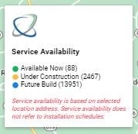
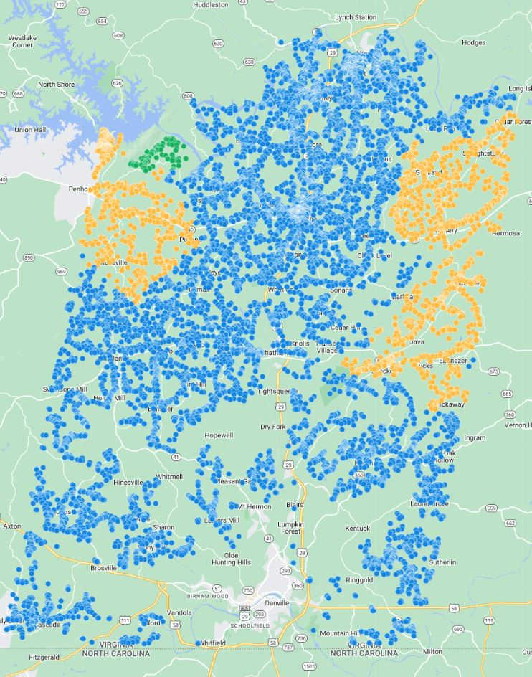
DOMO

Slide 19
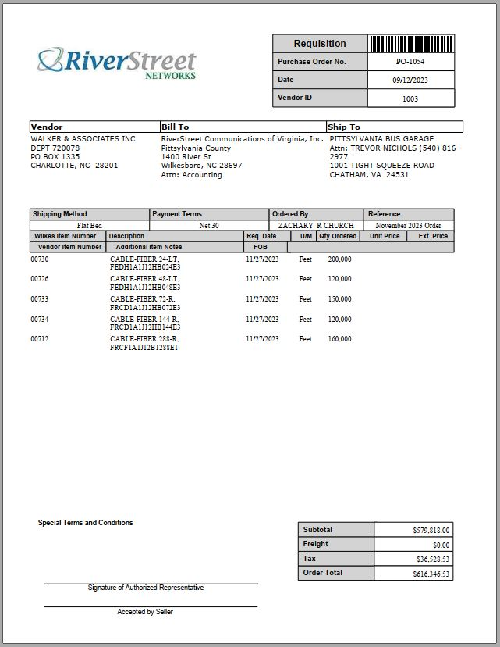
Materials
RSN - Netceed - Prysmian
guaranteed 9,000,000’ of cable
guaranteed pricing
monthly shipments
first 2 orders are placed
RSN - Charles Industries-pedestals
working to guarantee monthly shipments
with distributor or direct
RSN - ATS Sales-handhole/vaults
currently have monthly shipments
RSN - Graybar
minor materials
RSN - Genuine Cable Group
drop

Slide 20
What’s going to hold us up going forward?

Slide 22
QUESTIONS

